Slide 1
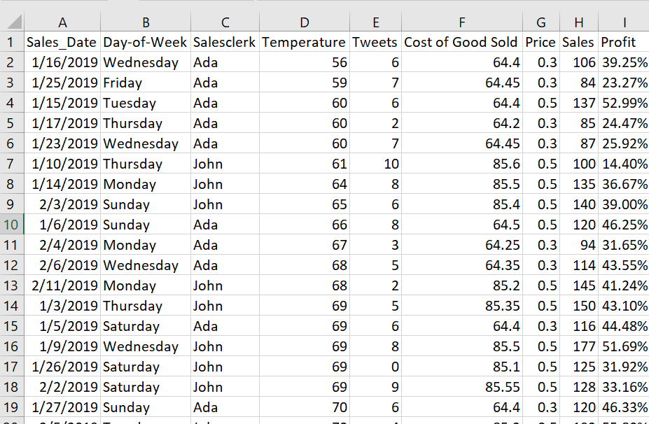
Story Telling: SuperCookies Store

Slide 2
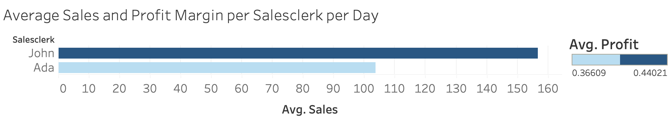
Story Telling: Fire or Keep Decision
Ada consistently has considerably lower sales than John, with a lower profit margin meaning she every day she works we lose money compared to expected value.

Slide 3

Story Telling: Fire or Keep Decision
I observed a huge performance difference between your sales employees. What are you going to do to fix this problem?

Slide 4
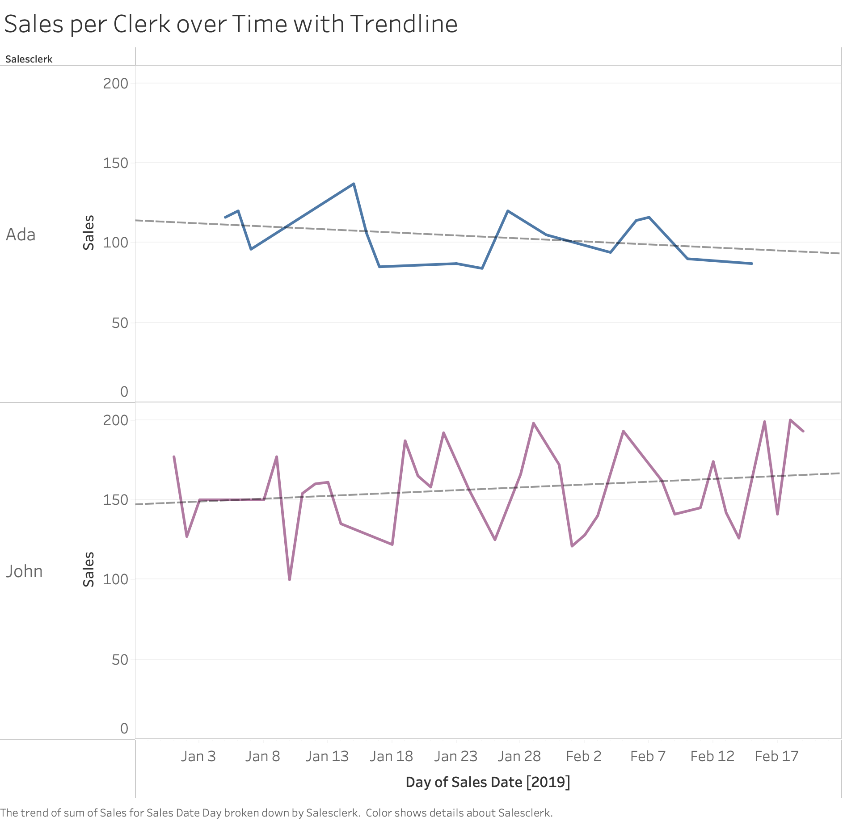
Story Telling: Fire or Keep Decision
Ada’s sales numbers are not only worse but they are also trending down, while John’s numbers are both higher and improving. When John was just starting out, his worse period, he was already preforming significantly better than when Ada was starting out which was her best period.

Slide 5
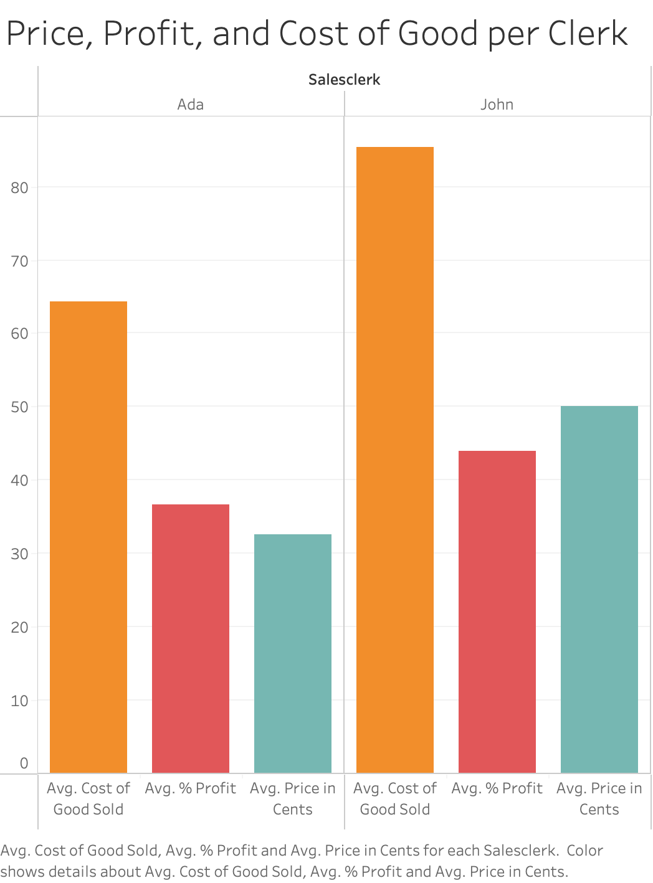
Story Telling: Fire or Keep Decision
Ada is not only selling fewer goods but is only selling lower cost items with a lower profit margin, resulting in lower daily profit margins.

Slide 6
Story Telling: Fire or Keep Decision
Write up part 1.
Ada struggles in all important metrics. She has lower sales numbers, lower profit margins, and sells fewer valuable items. Her performances are getting worse over time. She is costing the company money hand over foot. She must be fired!

Slide 7

Story Telling: Fire or Keep Decision
Counter Argument:
The case for Ada

Slide 8
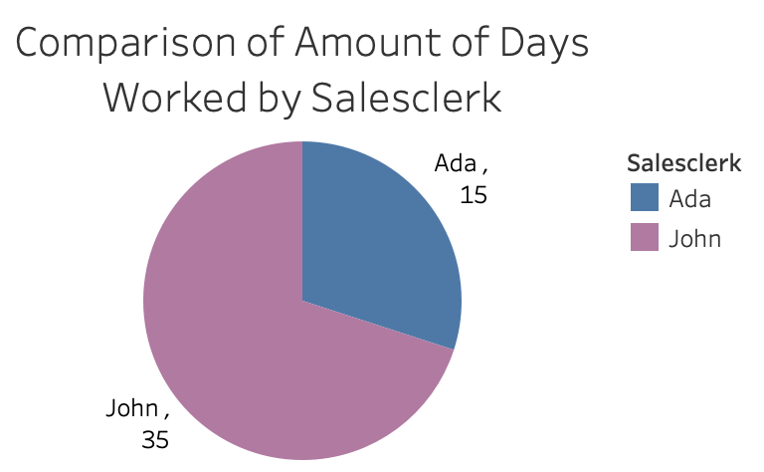
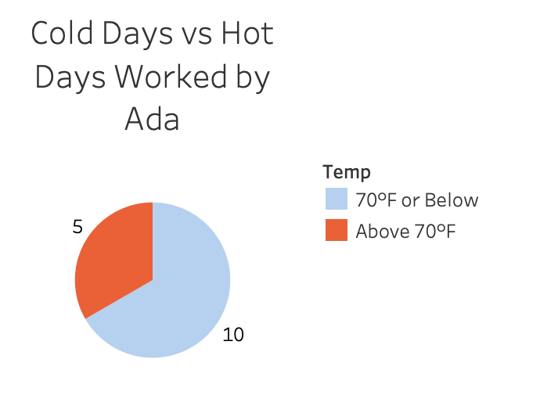
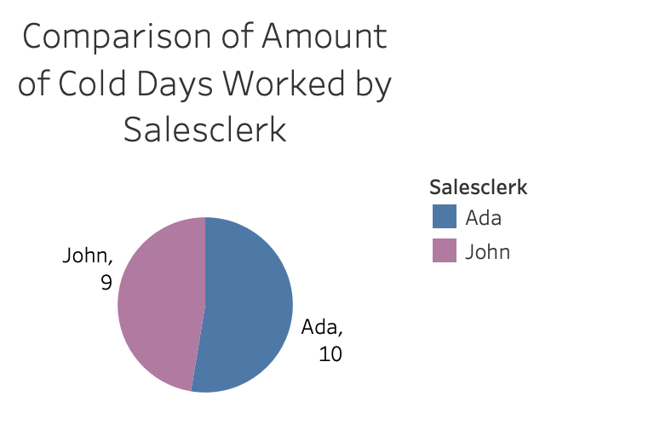
Story Telling: Fire or Keep Decision
John worked many more days in total, and Ada worked significantly more cold days than hot days and worked more cold days than John.

Slide 9
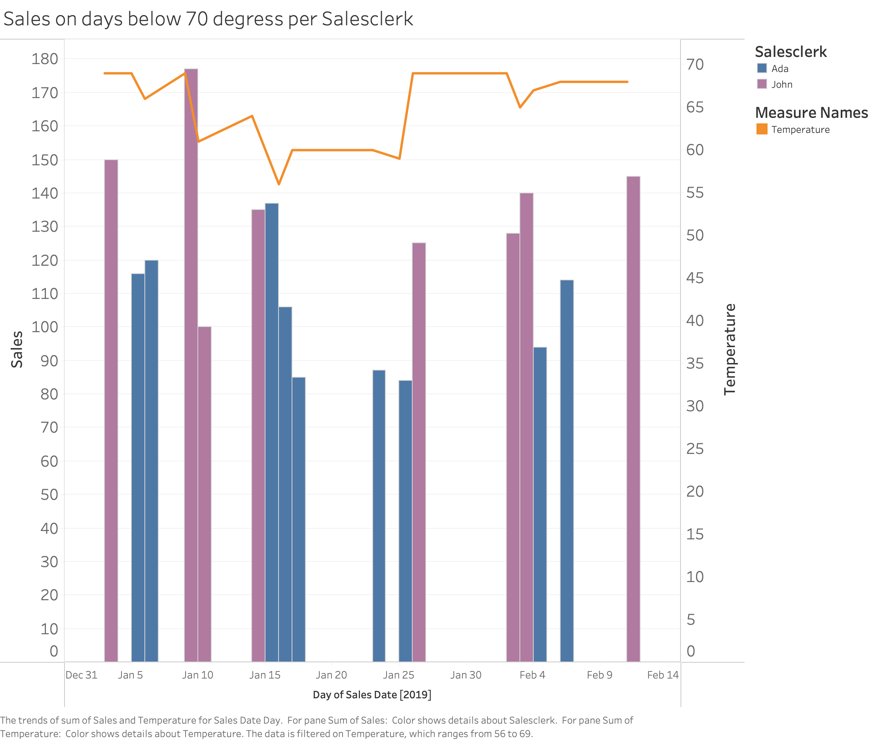
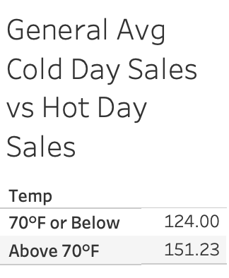
Story Telling: Fire or Keep Decision
Sales on cold days are lower overall on hot days and Ada’s sales on cold days (below 70 degrees) are lower but comparable to John’s

Slide 10
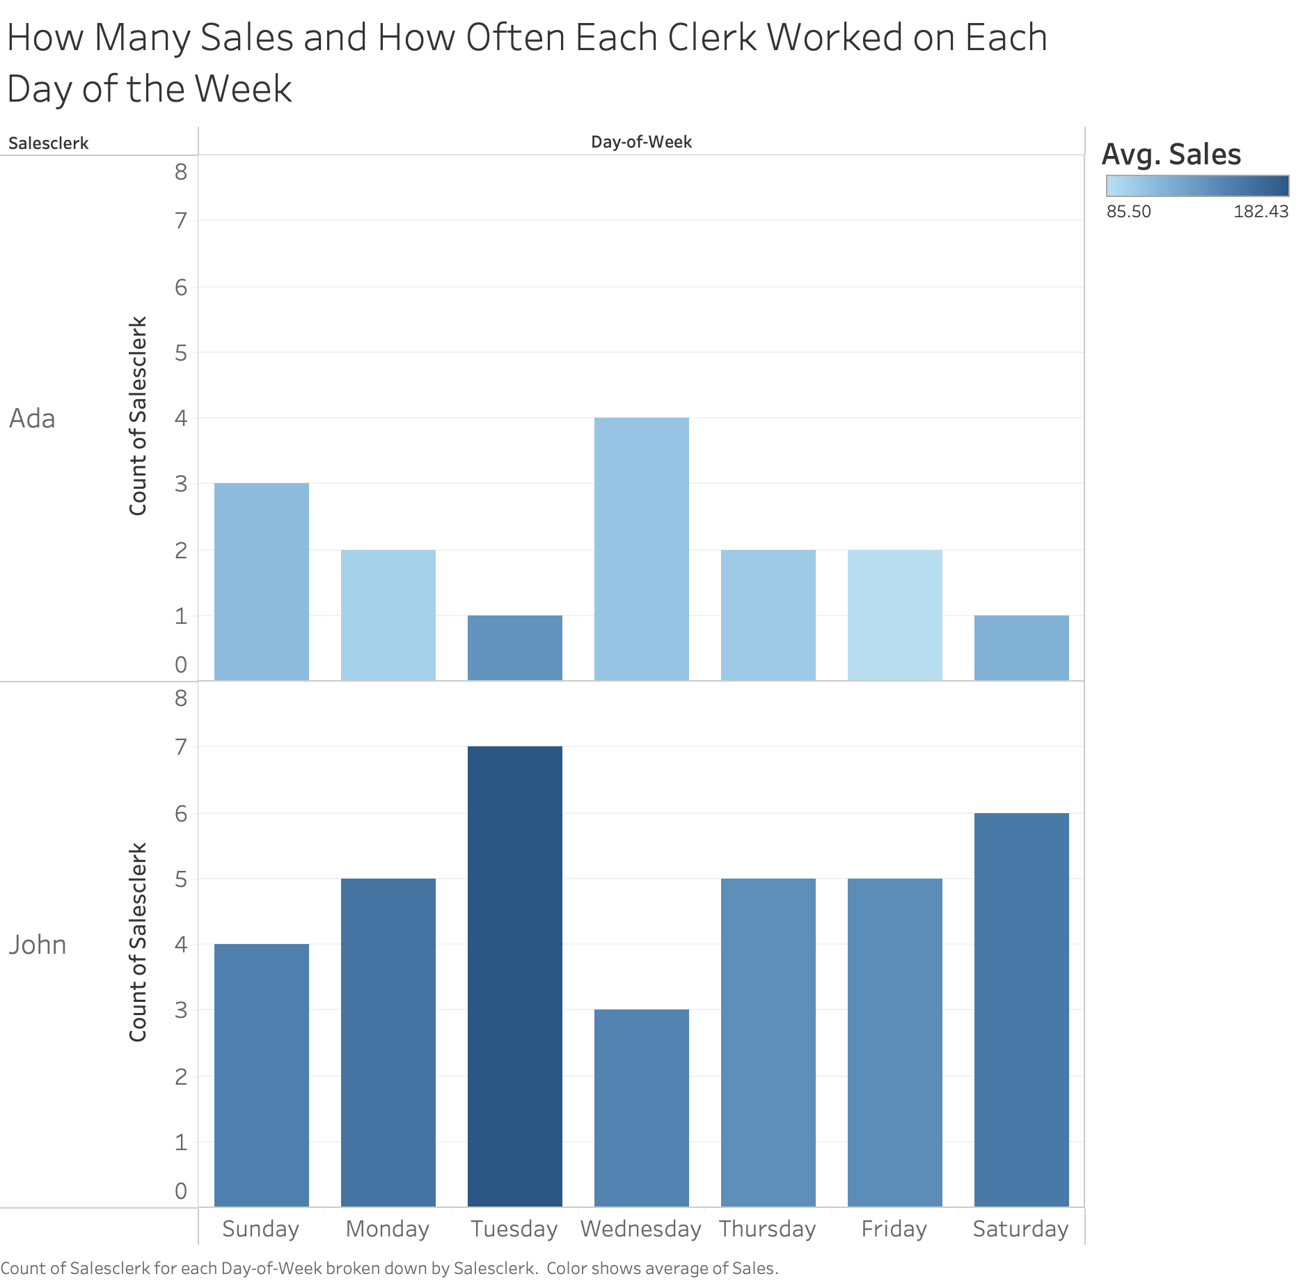
Story Telling: Fire or Keep Decision
Tuesday and Saturday were the days with the most sales for both Clerks, but Ada only got to work those days once each. Meanwhile she worked 8 times across Wednsedays, Thursdays, and Fridays which are three of the four lowest selling days of the week for both Clerks. Ada consistently worked the slowest days and the coldest days.

Slide 11
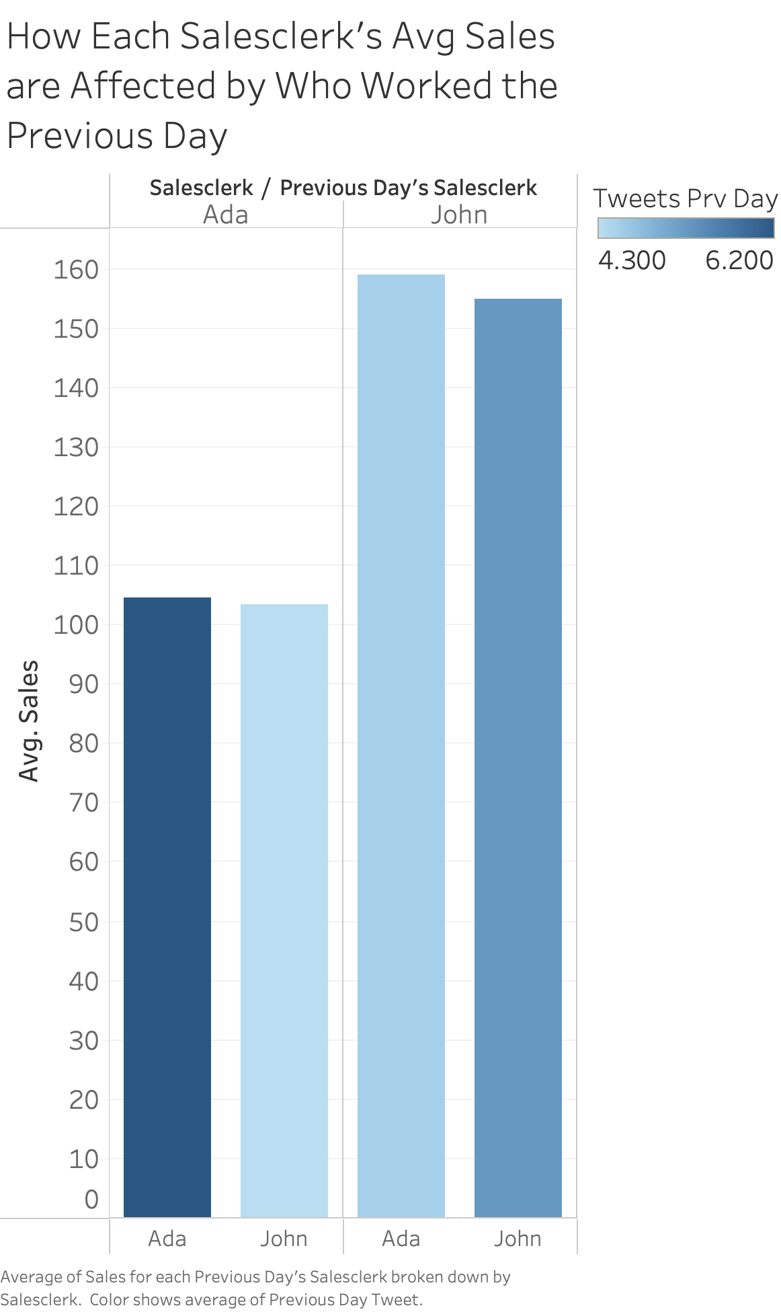
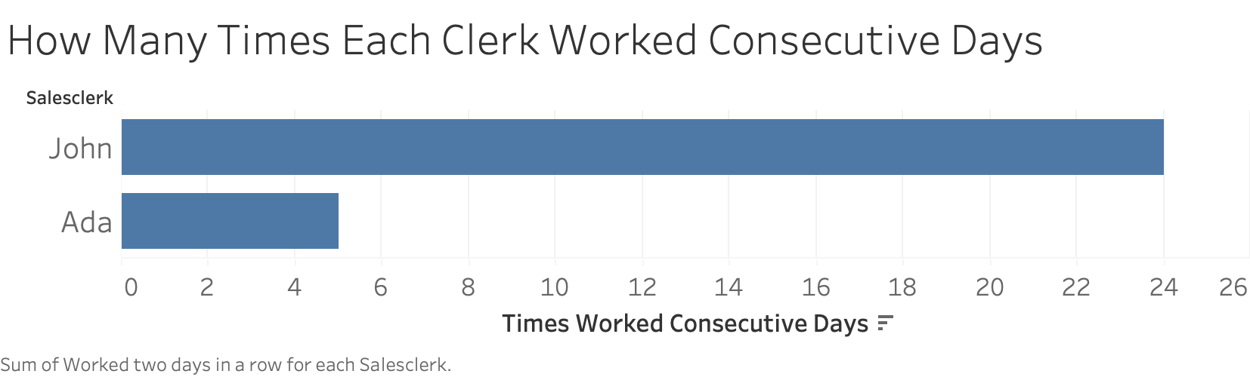
Story Telling: Fire or Keep Decision
No matter who was working, the next day that clerk would have higher sales if the person working the day before them was Ada. The business was mentioned in more tweets when either employee was working a second+ day in a row, but particularly for Ada, leading to potentially boosted sales days following Ada. However, Ada barely got to work any consecutive days. Combined with with working low temp days and on slow days, she was always set up to fail despite what she brings to the team

Slide 12
Story Telling: Fire or Keep Decision
Write up part 2.
Ada was set up to fail. She works all the slowest days of the week and works nearly over two thirds of her days on cold days. Whether it’s the tweets she brings to the business or some other factor, the business always does better the day after she works so she is doing something to bring in more customers, however she has not gotten the chance to work multiple days in a row like John has to enjoy the benefits of what she brings to the business. When she is working cold, slow, nonconsecutive days, then it is hard to believe that she is doing as well as she is. She should never have been fired and who ever wrote that recommendation is a fool or is out to get her!

Slide 13
Write up part 3.
At first finding anything to justify not firing Ada was quite difficult. Almost every statistic showed that she was inferior, and the ones that had any redeeming characteristics like the days where she worked being slower, or working days more with lower temperatures, it was hard to be sure if she was suffering from having to work those days bringing her numbers down, or if those days were slower because she was the one working more of those days. The fact that she couldn’t even seem to sell anything on hot days either was also evidence of this, though she had very few opportunities. It was only once for each one it was clear that there was also a drop off with John on those slow days that it became apparent just how hard it must have been to sell anything on most of the days she worked. Once it was also factored in that she was unable to work multiple days in a row and that seemed to being having an effect on her, then it was clear that she was always going to struggle.

